Slide 1
User Experience
Hyland Hackathon
Notes:
Hi my name is Hayleigh Wittal. I’m a User Experience Designer and have been at Hyland for 7 years now. <Insert Al>

Slide 2


User eXperience Team Goals
What does a User Experience team do?
Improve the software + customer relations
Make pleasant + productive products for end users
Software that does not frustrate or annoy them
Find innovative ideas in interaction technology
Attend conferences, learn from industry/research
Advocate for customer or user perspectives
Notes:
What does a User Experience team do?
One of the biggest things is that we improve the software and customer relations for a product
We try to make pleasant and productive products – We want to avoid software that frustrates or annoys people.
We are always looking for innovative ideas in interaction technology – We attend conferences and learn from industry and research. We might hear about something that’s working really well at Uber, and try to take those ideas and apply them to our work.
We are also always advocating for the customer or user. We try to see things as the customer or user does, and make sure they have a voice.

Slide 3



UX Stages
Research
Design
Test
Notes:
There are three stages to the UX Process
First, we have research
Next, we have design
And finally, we have test. These stages are often divided into different teams, where some people work on research and some work on design. They all work together to determine the experience!

Slide 4
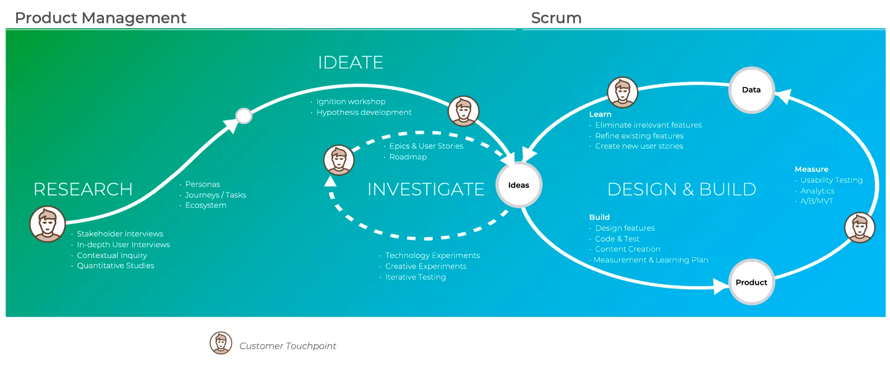
Notes:
Let’s take a look at this larger flow chart. Here we see how all of the user experience stages interact together.
On the left, we start things off with research. This is always the first part of a project. We then move into ideation, where the real planning begins.
Those ideas are evaluated, and then enter into the design phase! The design is iterative, and has many customer or user touchpoints along the way.
Once a product is developed, it can be tested, and the test data is incorporated back into the idea phase.
It’s a cycle that continues as long as a product is alive!

Slide 5
UX Stages
Research
Design
Test
Notes:
Now let’s dive a little deeper into the stages of UX, starting with research.

Slide 6

Research
Surveys
Observations
Interviews
Specialized tests
Analytic data
Scientific publications
Notes:
This is always the first part of a UX team’s process. There are several ways to find a framework for the design of a product.
One way is surveys – Researchers can put out wide-reaching surveys for potential customers or users and see what they want.
They can also directly observe interactions customers have with software, and see what might help them.
They can also do interviews with individuals – this is a great way to get deep perspectives from reliable sources.
They can run specialized tests to assess current needs.
They can look at analytic data for existing products.
They can read up on scientific publications to see what’s new and what can improve people’s lives.

Slide 7
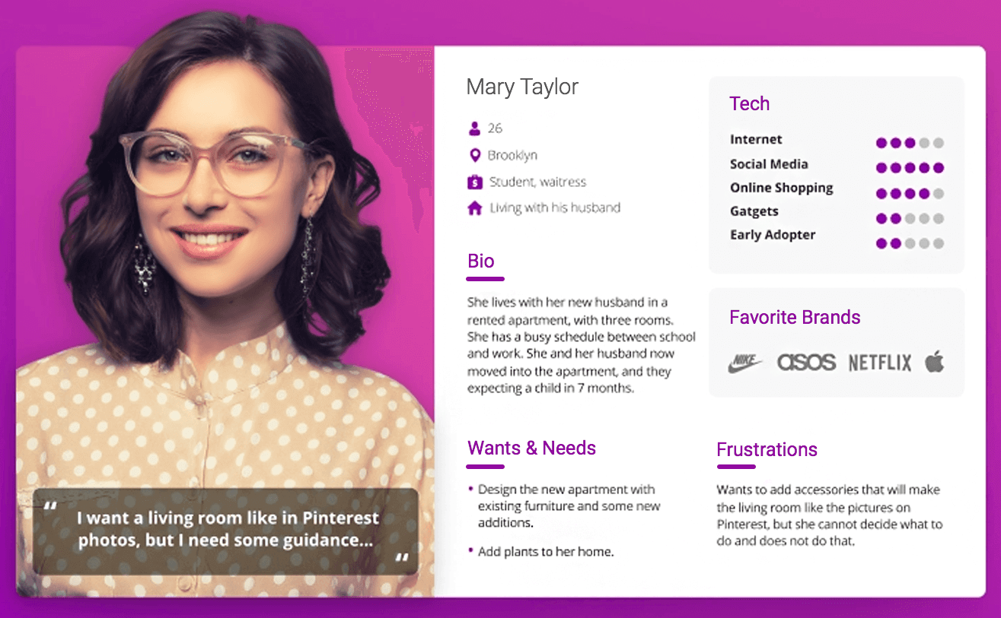
Personas
Research
User personas are archetypical users whose goals and characteristics represent the needs of a larger group of users.
Notes:
Another part of research is personas.
User personas are representative users whose goals and characteristics represent the needs of a larger group of users. In the very early stages, it is super important to define some personas.
A persona might look something like this one for Mary Taylor – they have an age, a location, a short bio, interest levels, favorite brands, frustrations, etc… this is just one example.
It’s important to know who a product serves…There are a ton of questions to ask when designing a product, and these personas help guide the design immensely.

Slide 8
UX Stages
Research
Design
Test
Notes:
Now let’s look at the design phase.

Slide 9

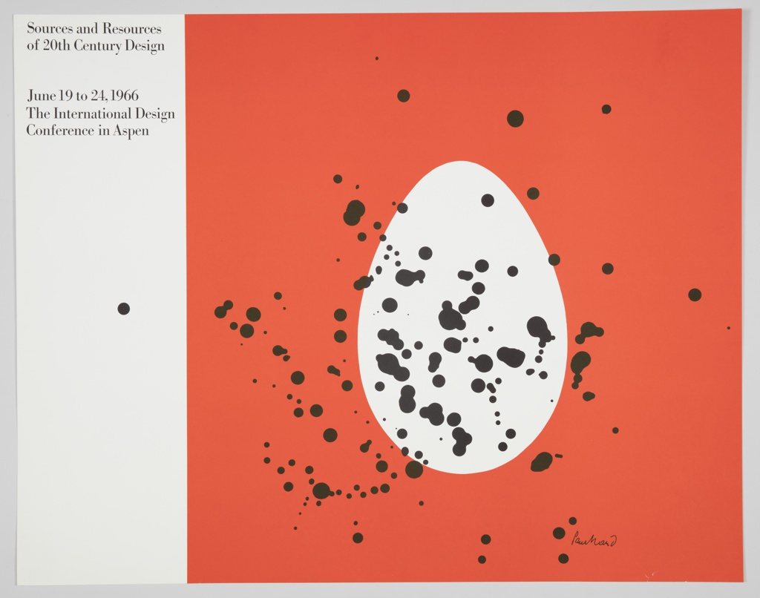
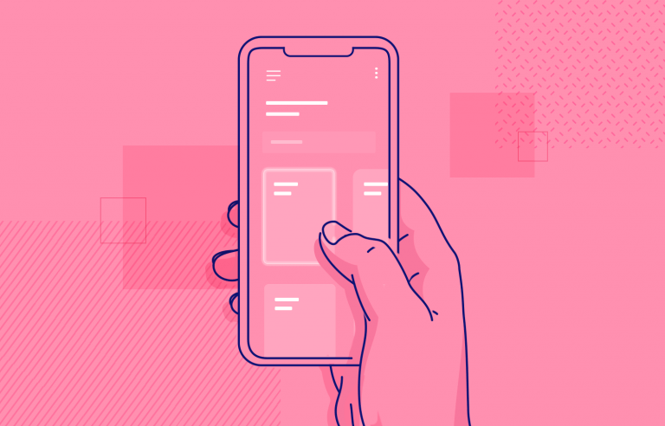
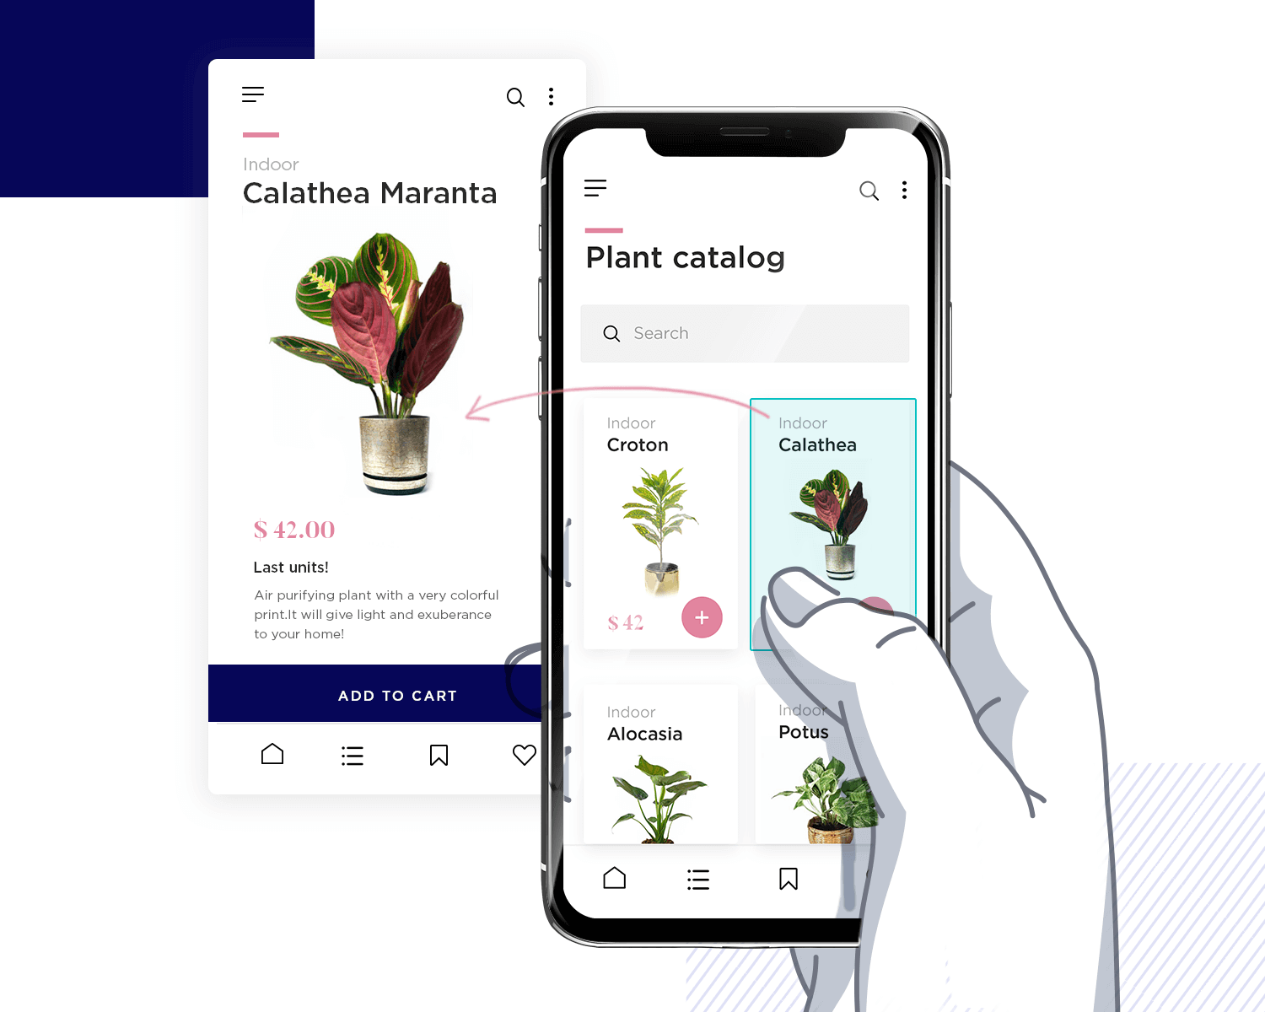
Design
Sketch sessions
Wire-framing
Interactive mockups
Coded prototypes
Applied research | Design guidelines | Best practices
Notes:
Many pieces go into the design of a product – it’s a lot more than just the colors and shapes!
Design usually starts with some sketch sessions. These help lay out the placement of the features on paper.
Next, these features are made more concrete through wireframing. A wireframe is a layout of a screen that demonstrates what interface elements will exist in key areas – this is where the actual layout starts to take shape.
After wireframes, we create interactive mockups – not fully functional, but visually functional.
From there, we sometimes create coded prototypes – these usually don’t have actual data or features, but they can help a lot from a UX perspective.
During all this design, it is important to keep a lot of things in mind, such as applying research, following design guidelines, and following best practices. These help make we are doing our absolute best based on the latest knowledge and cohesive product treatment.

Slide 10
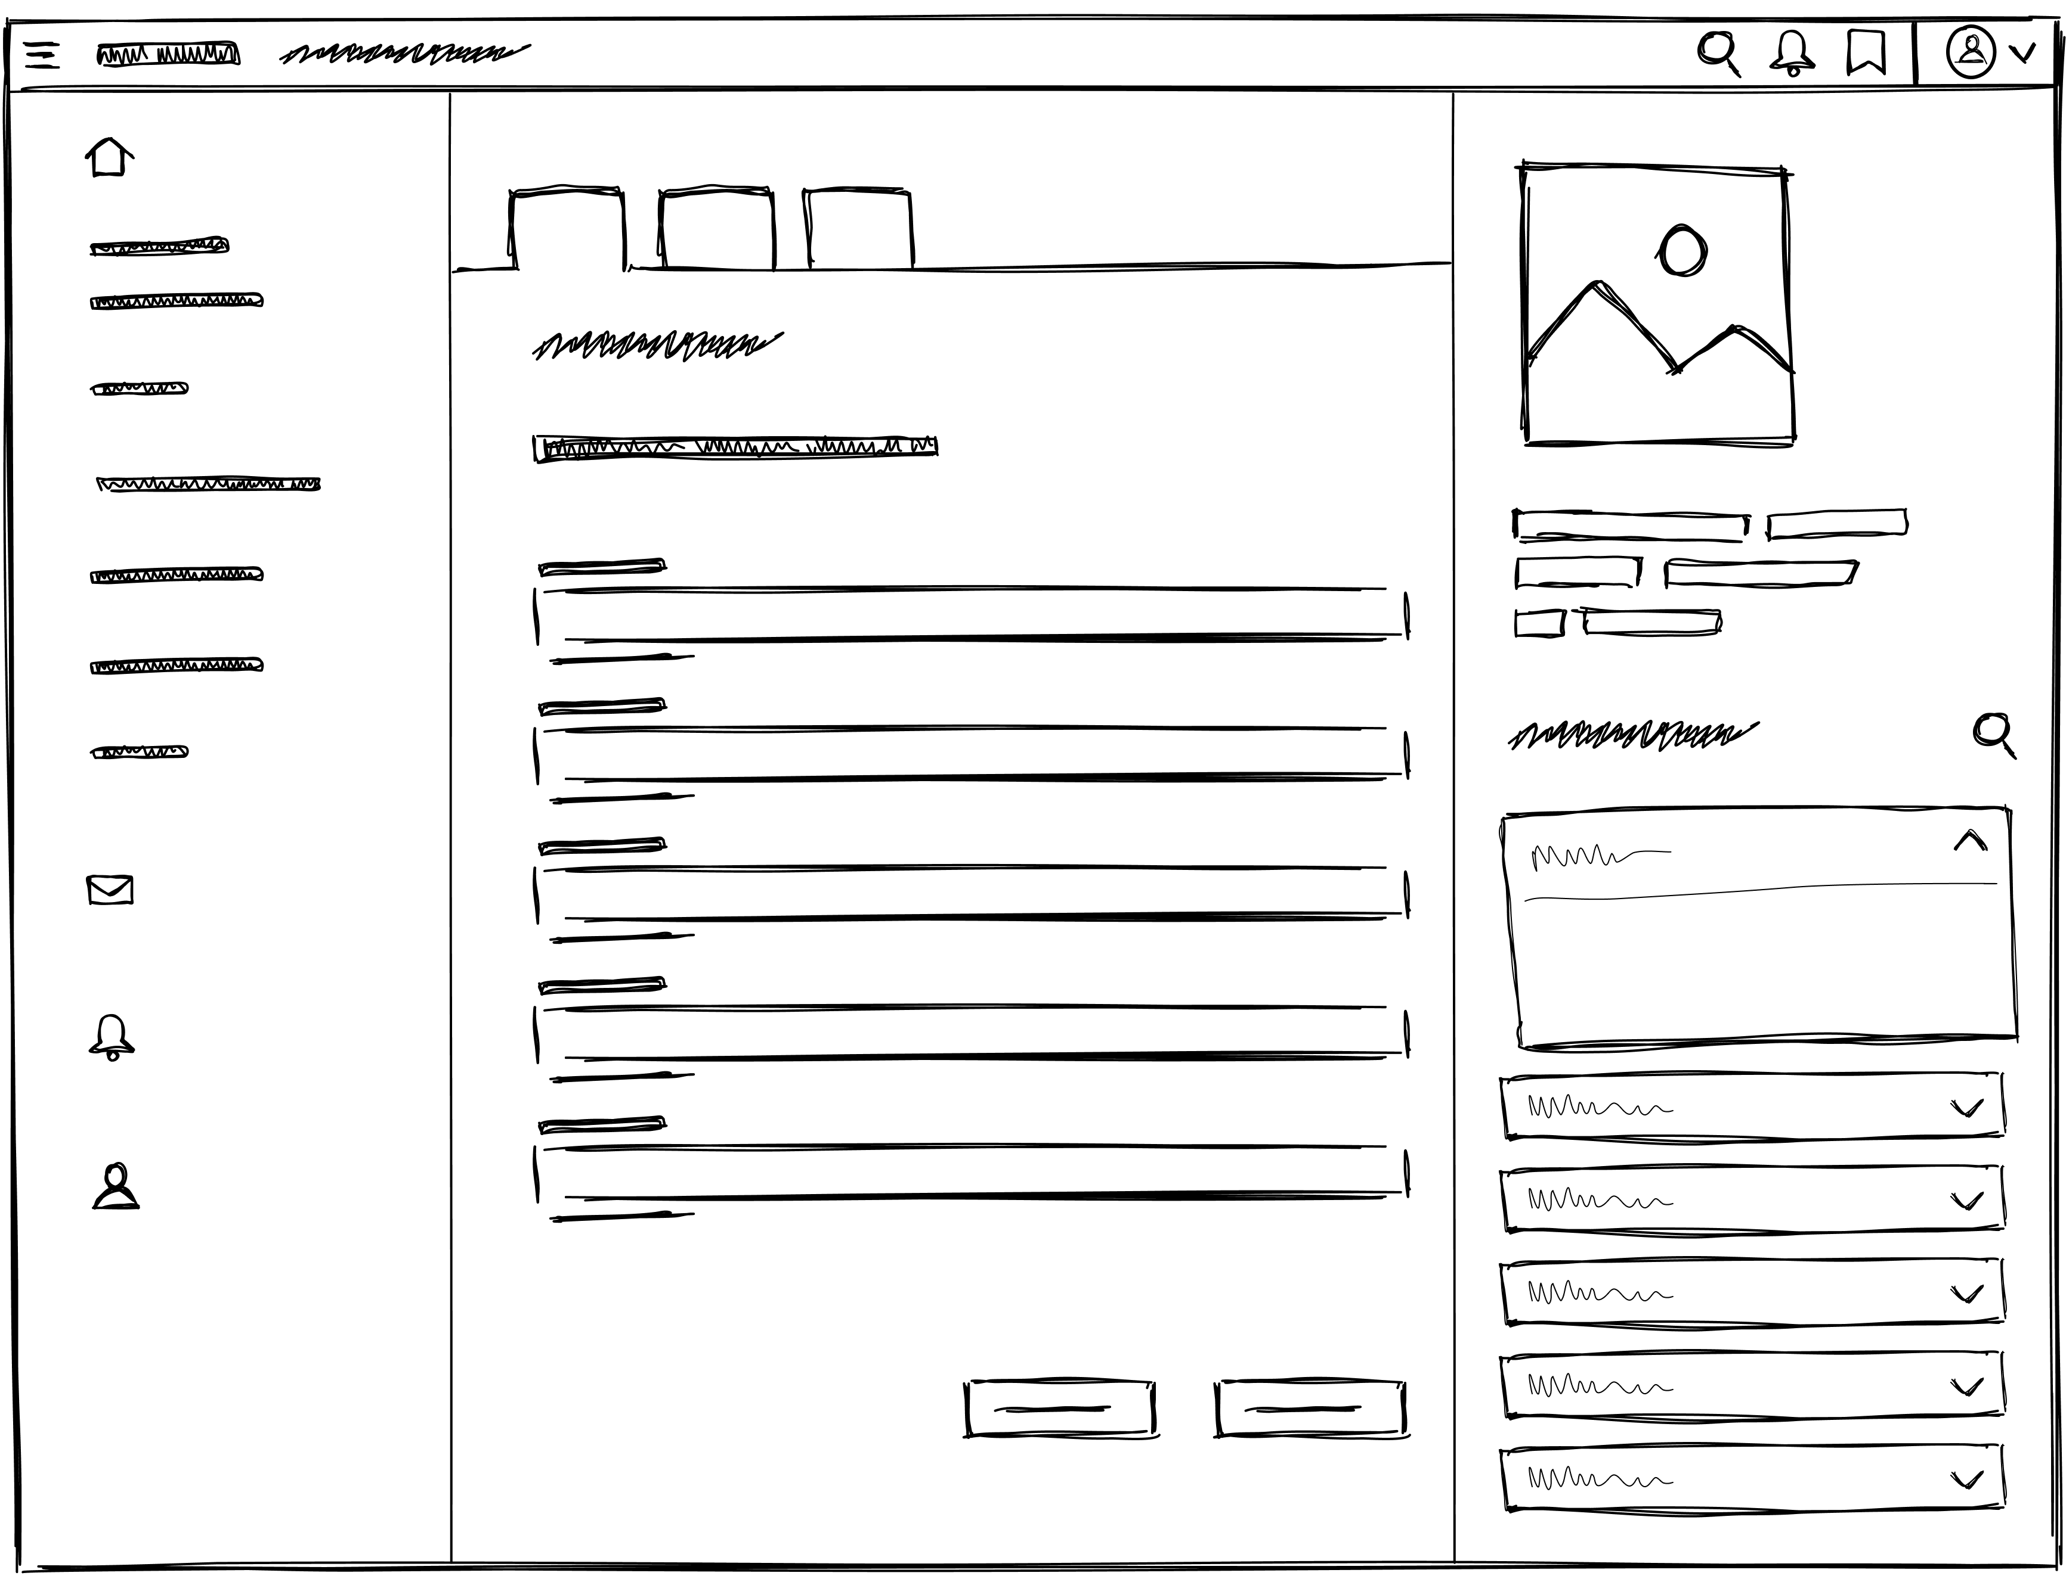
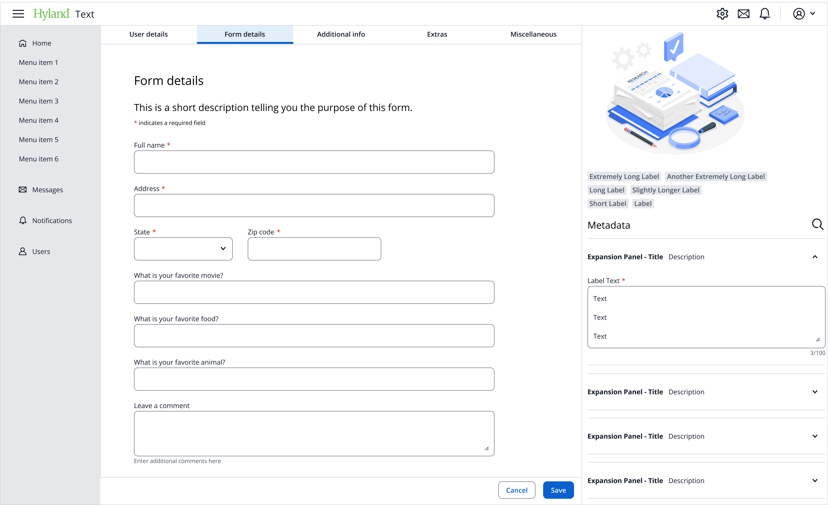
Design
Explore designs in different levels of detail (low fidelity → high fidelity)
Notes:
Designers will explore solutions in different levels of detail, what we call “fidelity” or how closely does this resemble the final design?
Low-fidelity is typically sketched out on paper or with specialized pieces created in our design software. It’s used to get an idea of what parts need to be in the design and how they should be arranged, without getting too bogged down by details like color and typography and spacing.
High-fidelity comes as close to the final design as we can make it short of actually coding a prototype. Colors, type, icons, etc. all match how the look and feel of production components. We can even build in some interactivity at this stage.

Slide 11
UX Stages
Research
Design
Test
Notes:
Once a product has been researched and designed, it’s actually out there in the wild! The next step is to test it.

Slide 12
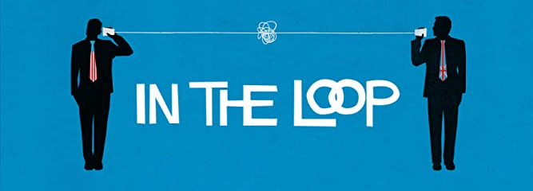
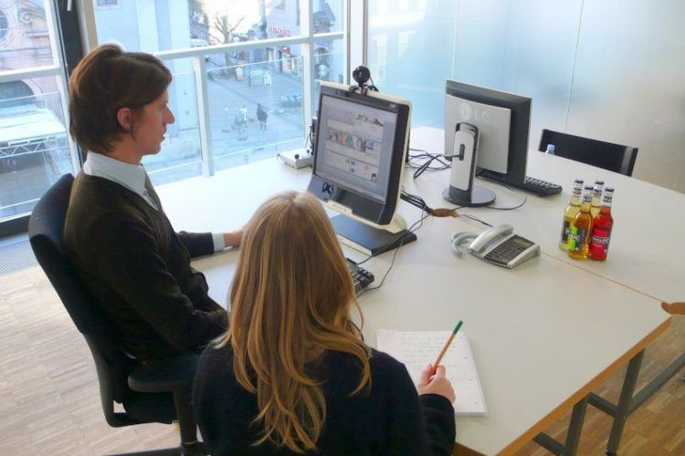
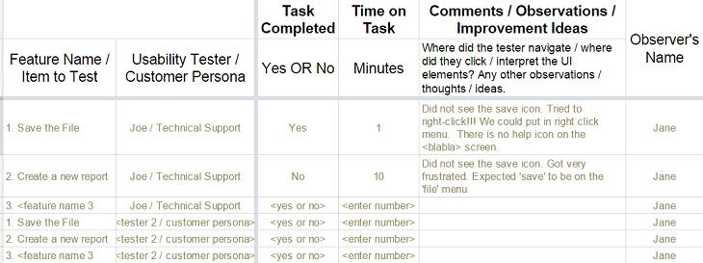
Test
Closing the Loop
Moderated and unmoderated online tests
In-lab or remote tests
Utilizing test data
Notes:
Testing a product is a way to close the loop – did all that research actually pay off? Do people actually use it as it is intended?
There are many different types of tests. Online tests are an easy way to get a lot of data – there can be value in moderated tests, or unmoderated tests. Moderated tests will provide more pointed observations, while unmoderated tests might help reveal unforeseen limitations or use cases.
There are also more specific tests that can take place in a lab or remotely. In-lab tests are great because it is possible to observe everything a user is doing – remote tests can do this as well.
Finally, it’s important to utilize the test data to make changes to the product as needed. This is where it loops back around to the research and design stages – taking this data and incorporating it back into the product.

Slide 13
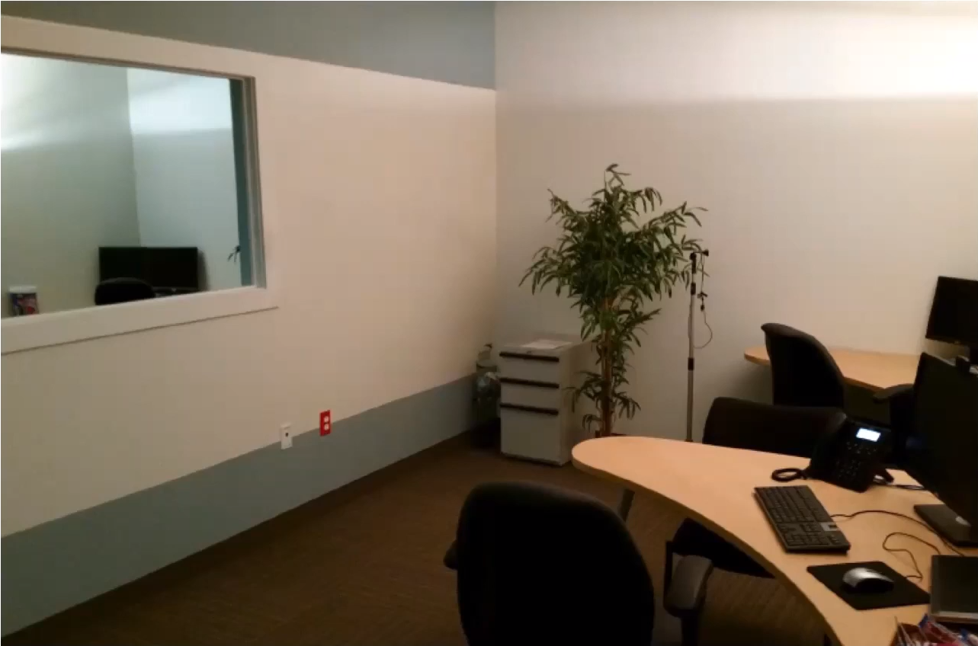
THE LAB
Test
Comfortable Good Lighting
One-way Mirror
Notes:
Here’s a picture of the actual UX lab at Hyland!
Some key features are that it is comfortable, it has good lighting, and there’s a one-way mirror. The team can observe test subjects without interfering. This helps a lot; sometimes, subjects will say they really like a feature, but not know how to use it very well. Some of the computers even have webcams equipped with eye-tracking technology which can help the team determine where people look when they’re lost, how they view the screens, and what would be the best places to help them. All of this is designed to really hear from the customers and connect their perspectives to the design process.

Slide 14
UX Stages
Research
Design
Test
Notes:
And that is all three stages! Each one of them is super important, and they all work together to create the ultimate experience for the user.

Slide 15


How to Pursue UX
College Degrees
Human Computer Interaction
Computer Science / CIS
Design
UXPA (UX Professionals Association)
Apply for Internships
Notes:
How might you get involved in this type of career?
If you go to college, there are a few degrees that could help significantly…
Human Computer Interaction
Computer Science or Information Science
Design
That said, it’s not always necessary to go to college if you want to work in UX. One thing you can do is join UXPA – they have conferences and articles that can help you enhance your UX skills significantly
Another great way is to apply for internships.

Slide 16
THANK YOU!
WHAT QUESTIONS DO YOU HAVE?
Notes:
Anyone have any questions? Thank you!

Slide 17

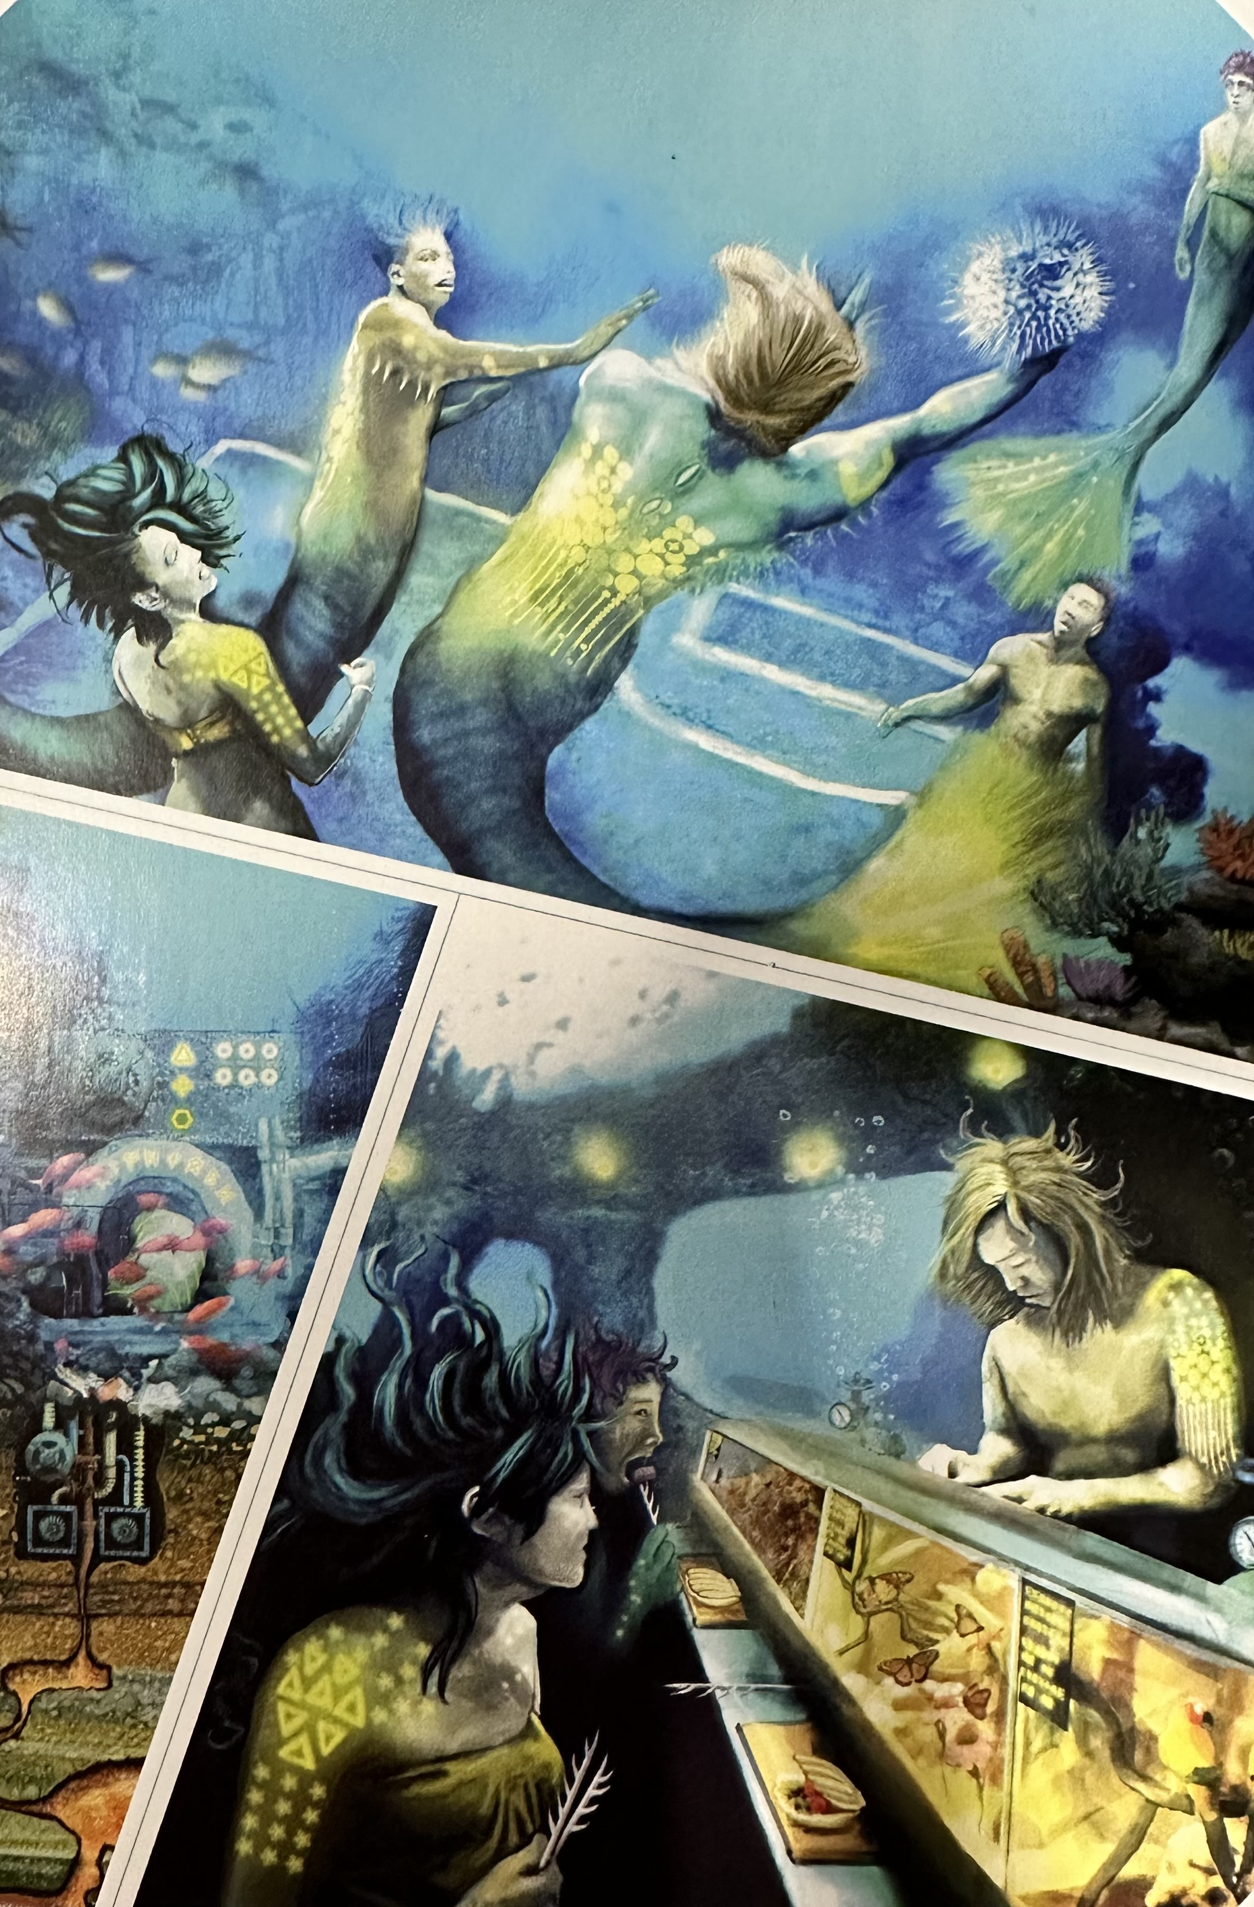
Activity: Design for a Merman
A Timekeeper
Somewhere to Sit
Somewhere to Sleep
RESEARCH
How could we improve your experience?
Look closely at the Merman's appearance. Observe his unique features and abilities. What will you need to consider in your design?
What materials will you use to make your invention? What materials might exist in the Merman's world?
Notes:
Now it’s time for an activity! You’re going to design something for a Merman. You can design…
A timekeeper, somewhere to sit, or somewhere to sleep.
We’re going to start with some research… what types of questions would you ask the Merman or things do you need to consider before jumping into the design?
Here are some potential questions and things to consider – how could we improve your experience, Look closely at the Merman's appearance. Observe his unique features and abilities. What will you need to consider in your design? What materials will you use to make your invention? What materials might exist in the Merman's world?

Slide 18
Products
1. Choose one of these products to design (A Timekeeper, Somewhere to Sit, Somewhere to Sleep)
2. List features
3. Sketch!
Notes:
Now it’s time to design! Here are the products again...
Start by choosing one of the products to design
Once you have the product, list out some important features. Try to think about what you could use from the real world to create these features on a giant scale
Last, it’s time to sketch! You can use a paper and pen
Take approximately 5 minutes for this activity!

Slide 19
Product Design Review
Notes:
Time’s up! Let’s review what everybody designed.

